Slide 1

הרצאה 8
Virtual Machine II
מעבדה במחשבים מחומרה לתוכנה
קורס 10083
אריק גיספאן arikgi@post.jce.ac.il

Slide 2
Lecture plan
Goal: Specify and implement a VM model and language
Arithmetic / Boolean commands
add
sub
neg
eq
gt
lt
and
or
not
Memory access commands
pop segment i
push segment i
Program flow commands
label (declaration)
goto (label)
if-goto (label)
Function calling commands
function (declaration)
call (a function)
return (from a function)
Previous
lecture
This
lecture
Method: (a) specify the abstraction (model’s constructs and commands) (b) propose how to implement it over the Hack platform.

Slide 3
The challenge ahead
if ~(a = 0)
x = (-b + sqrt(power(b,2) – 4 * a * c)) / (2 * a)
else
x = - c / b
To translate such high-level code to VM code, we have to know how to handle:
Arithmetic operations (last lecture)
Boolean operations (last lecture)
Program flow (this lecture, easy)
Subroutines (this lecture, less easy)
In the Jack/Hack platform: all these abstractions are delivered by the VM level (rather than by the compiler).

Slide 4

Program structure and translation path (on the Hack-Jack platform)
Jack source code:
Following compilation:
class Foo {
static staticsList;
method f1(argsList) {
var localsList;
...
}
method f2(argsList) {
var localsList;
...
}
function f3(argsList) {
var localsList;
...
}
}
Compiler
class Bar {
static staticsList;
function f1(argsList){
...
}
method f2(argsList) {
var localsList;
...
}
}
One file

Slide 5
Program flow
Example:
function mult 2
push constant 0
pop local 0
push argument 1
pop local 1
label loop
push local 1
push constant 0
eq
if-goto end
push local 0
push argument 0
add
pop local 0
push local 1
push constant 1
sub
pop local 1
goto loop
label end
push local 0
return
label c
goto c
if-goto c // pop the topmost stack element; // If it’s not zero, jump
Implementation (by translation to assembly): Simple. Label declarations and goto directives can be effected directly by assembly commands.

Slide 6
Subroutines
if ~(a = 0)
x = (-b + sqrt(power(b,2) – 4 * a * c)) / (2 * a)
else
x = - c / b
Subroutines = a major programming artifact
The primitive (given) language can be extended at will by user-defined commands ( AKA subroutines / functions / methods ...)
The primitive commands and the user-defined commands have the same look-and-feel
Perhaps the most important abstraction delivered by programming languages. The challenge: to make the implementation of this abstraction as transparent as possible:
“A well-designed system consists of a collection of black box modules, each executing its effect like magic” (Steven Pinker, How The Mind Works)

Slide 7
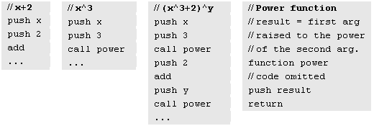
Subroutines usage at the VM level (pseudo code)
Call-and-return convention
The caller pushes the arguments, calls the callee, then waits for it to return
Before the callee terminates (returns), the callee must push a return value
At the point of return, the callee’s resources are recycled, and the caller’s state is re-instated
Caller’s net effect: the arguments were replaced by the return value (just like with primitive operations)
Behind the scene
Recycling and re-instating subroutine resources and states is a major headache
Some behind-the-scene agent (the VM or the compiler) should manage it “like magic”
In our implementation, the magic is stack-based, and is considered a great CS gem.

Slide 8
Subroutine commands
function g nVars
(Here starts a function called g, which has nVars local variables)
call g nArgs
(Invoke function g for its effect; nArgs arguments have been pushed onto the stack)
Return
(Terminate execution and return control to the calling function)
Implementation: Next few slides.

Slide 9
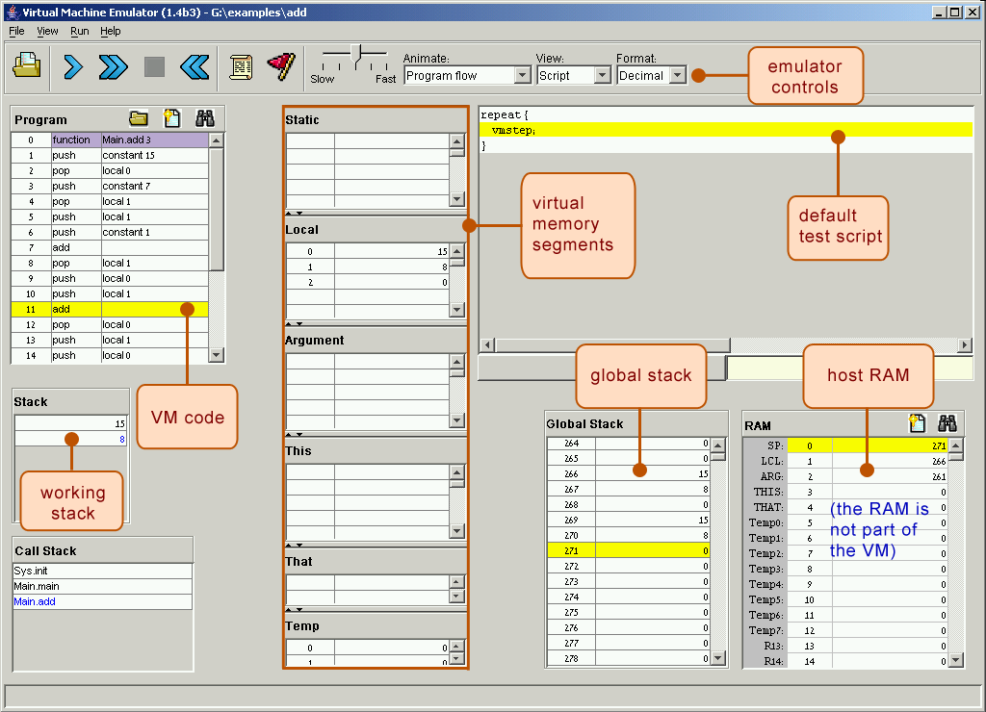
Aside: The VM emulator (Java-based, included in the course software suite)
Calling hierarchy

Slide 10
The function-call-and-return protocol
function g nVars
call g nArgs
return
The caller’s view:
Before calling the function, I must push as many arguments as needed onto the stack
Next, I invoke the function using the call command
After the called function returns:
The arguments that I pushed before the call have disappeared from the stack, and a return value (that always exists) appears at the top of the stack
All my memory segments (argument, local, static, …) are the same as before the call.
Blue = function writer’s responsibility
Black = black box magic, supplied by the VM implementation
In other words, we have to worry about the “black operations” only.
The callee’s view:
When I start executing, my argument segment has been initialized with actual argument values passed by the caller
My local variables segment has been allocated and initialized to zero
The static segment that I see has been set to the static segment of the VM file to which I belong, and the working stack that I see is empty
Before exiting the function, I must push a value onto the stack and then RETURN.

Slide 11
VM implementation view of the function-call-and-return protocol
function g nVars
call g nArgs
return
When function f calls function g, I must:
Save the return address
Save the virtual segments of f
Allocate, and initialize to 0, as many local variables as needed by g
Set the local and argument segment pointers of g
Transfer control to g.
When g terminates and control should return to f, I must:
Clear g ’s arguments and other junk from the stack
Restore the virtual segments of f
Transfer control back to f (jump to the saved return address).

Slide 12
The VM implementation storage housekeeping = the stack
At any point of time, some functions are waiting, and only the current function is running
Shaded areas: irrelevant to the current function
The current function sees only the top of the stack (AKA working stack)
The rest of the stack holds the frozen states of all the functions up the calling hierarchy
Physical storage details depend on the VM implementation.

Slide 13
Example: a typical calling scenario
function fact(n) {
function mult(x,y) {
vars result,j;
vars sum,j;
function p(...) {
result=1; j=1;
sum=0; j=y;
...
while j<=n {
while j>0 {
... fact(4) ...
result=mult(result,j);
sum=sum+x;
}
j=j+1;
j=j+1;
}
}
return result;
return sum;
}
}

Slide 14
Behind the scene:
function p(...) {
...
... fact(4) ...
}
function fact(n) {
vars result,j;
result=1; j=1;
while j<=n {
result=mult(result,j);
j=j+1;
}
return result;
}
function mult(x,y) {
vars sum,j;
sum=0; j=y;
while j>0 {
sum=sum+x;
j=j+1;
}
return sum;
}

Slide 15
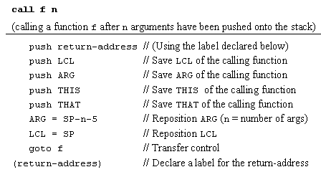
Implementing the call f n command
If the VM is implemented as a program that translates VM code to assembly code, the translator should generate the above logic in assembly.

Slide 16
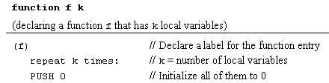
Implementing the function f k command
If the VM is implemented as a program that translates VM code to assembly code, the translator should generate the above logic in assembly.

Slide 17

Implementing the return command
If the VM is implemented as a program that translates VM code to assembly code, the translator should generate the above logic in assembly.

Slide 18
One more detail: bootstrapping
A high-level jack program (AKA application) is a set of class files. By a Jack convention, one class must be called Main, and this class must have at least one function, called main. The contract: when we tell the computer to execute the program, the function Main.main starts running
Implementation:
After the program is compiled, each class file is translated into a .vm file
From the host platform’s standpoint, the operating system is also a set of .vm files (AKA “libraries”) that co-exist alongside the user’s .vm files
One of the OS libraries is called Sys, which includes a method called init. The Sys.init function starts with some OS initialization code (we’ll deal with this later, when we discuss the OS), then it does call f and enters an infinite loop; If the application was written in the Jack language, then by convention call f should be call Main.main
Thus, to bootstrap, the VM implementation has to effect (e.g. in assembly), the following operations:
SP = 256 // initialize the stack pointer to 0x0100
call Sys.init // the initialization function

Slide 19
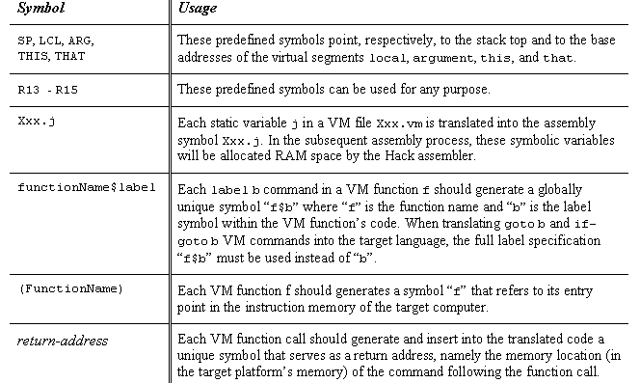
VM implementation over the Hack platform
Extends the VM implementation proposed in the last lecture (chapter 7)
The result: a big assembly program with lots of agreed-upon symbols:

Slide 20
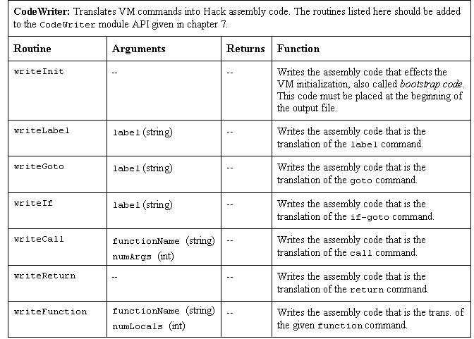
Proposed API

Slide 21
Perspective
Benefits of the VM approach
Code transportability: compiling for different platforms requires replacing only the VM implementation
Language inter-operability: code of multiple languages can be shared using the same VM
Common software libraries
Code mobility: Internet
Modularity:
Improvements in the VM implementation are shared by all compilers above it
Every new digital device with a VM implementation gains immediate access to an existing software base
New programming languages can be implemented easily using simple compilers
Benefits of managed code:
Security
Array bounds, index checking, …
Add-on code
Etc.
VM Cons
Performance.

